Slide 1
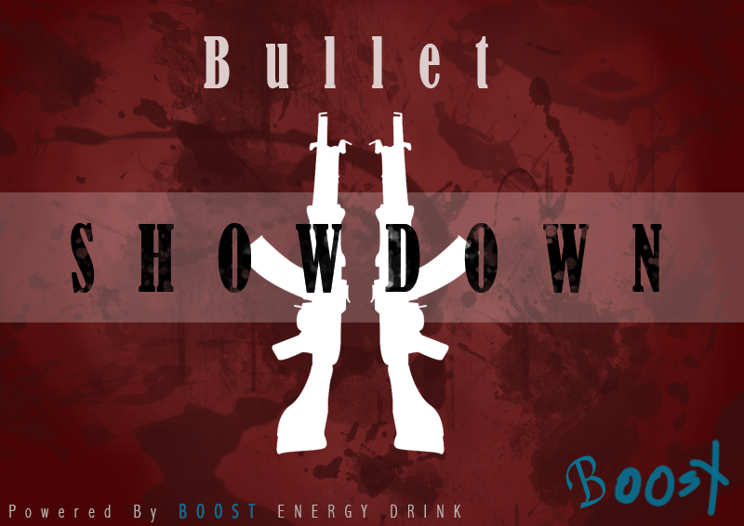
Presented by 8-bit Bacon

Slide 2
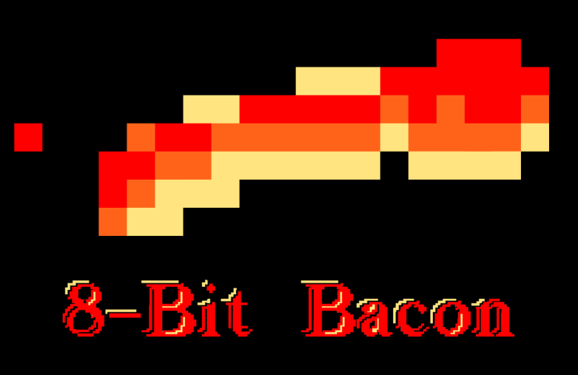




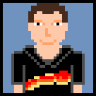

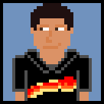


Our Team
Programmers
Artists
Anton
Lopez
Charles “CJ” Meade
Daniel
Lima
Justin
Maza
Matthew Birky
Roberto Rubiano
Sean
Welch
Oscar
Araque
Santiago Hoyos

Slide 3
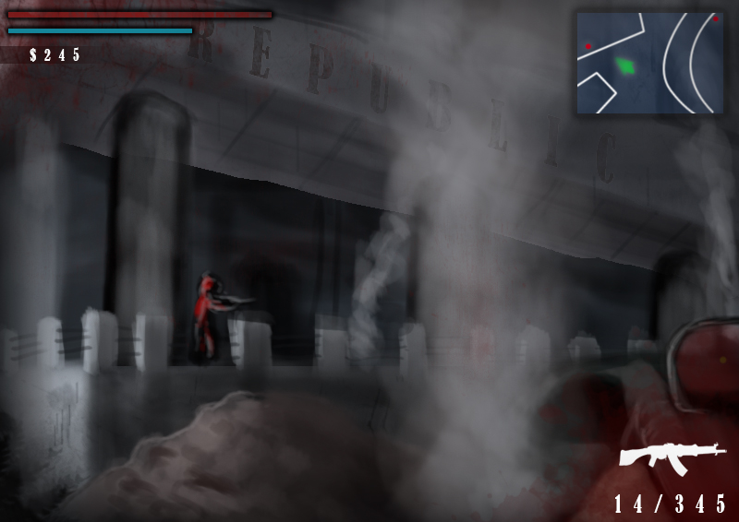
Game Vision
Boost is a fast-paced, intense 1st person shooter game.

Slide 4

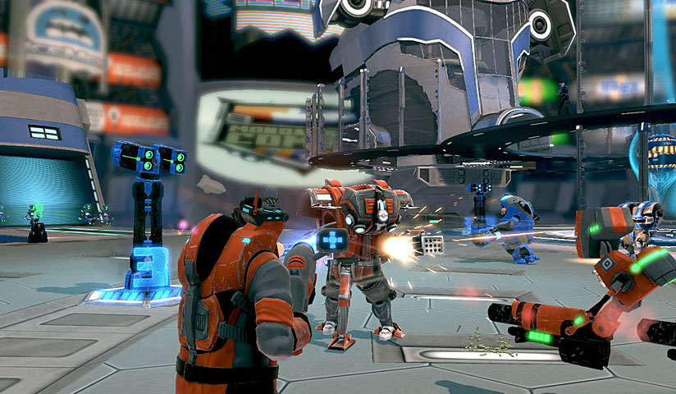
Inspiration

Slide 5
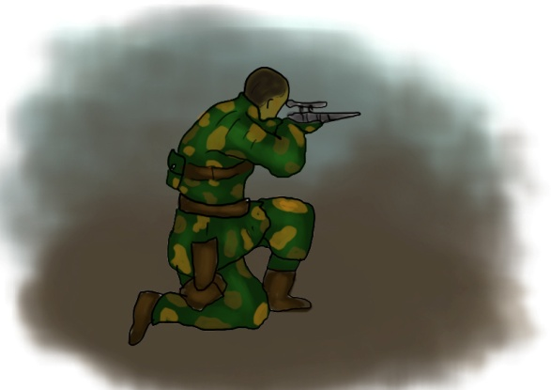
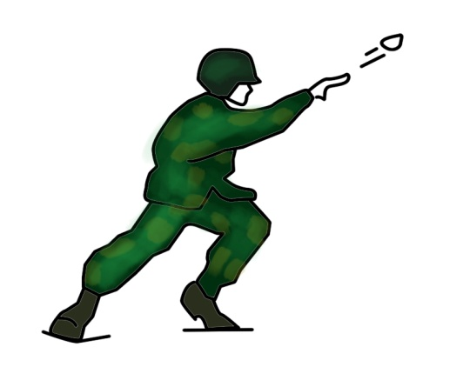
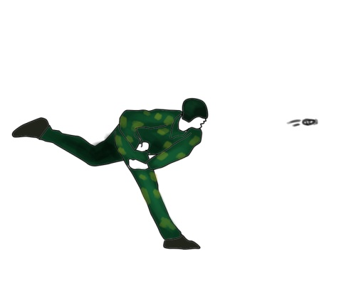
Player Actions
Shoot
50%
Boost
50%

Slide 6
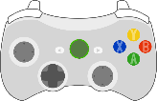


Right Trigger
Shoot
Mouse Left Click
Player shoots with their equipped weapon.
Damage enemies or manipulate the environment

Slide 7
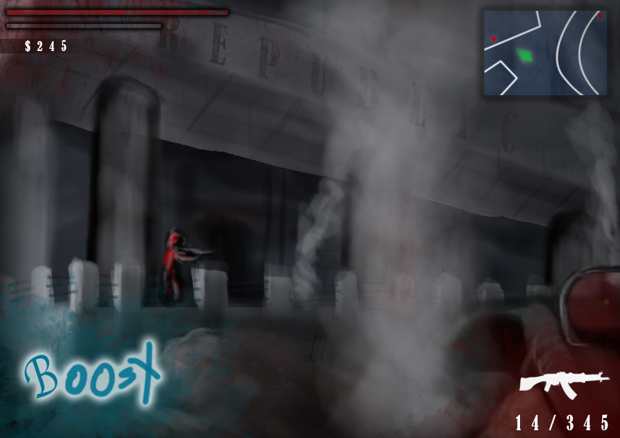
Left Trigger
Boost
Space Bar
Gives more power to player abilities
Dodge enemy fire
Sprint forward
Knock enemies with melee

Slide 8
Game Flow

Slide 9
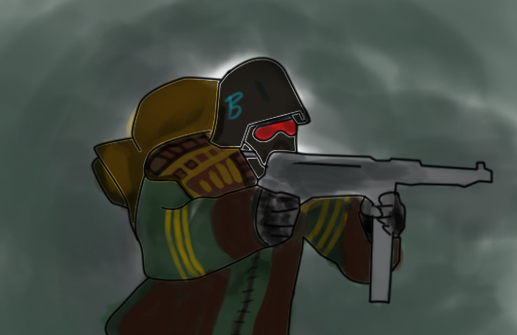
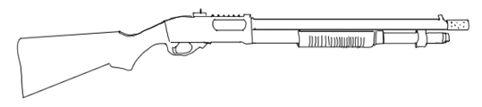
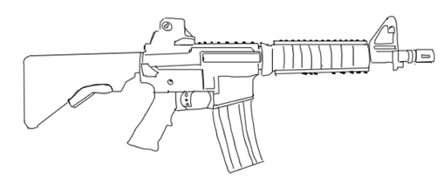
Enemies
Shotgun
Assault Rifle

Slide 10
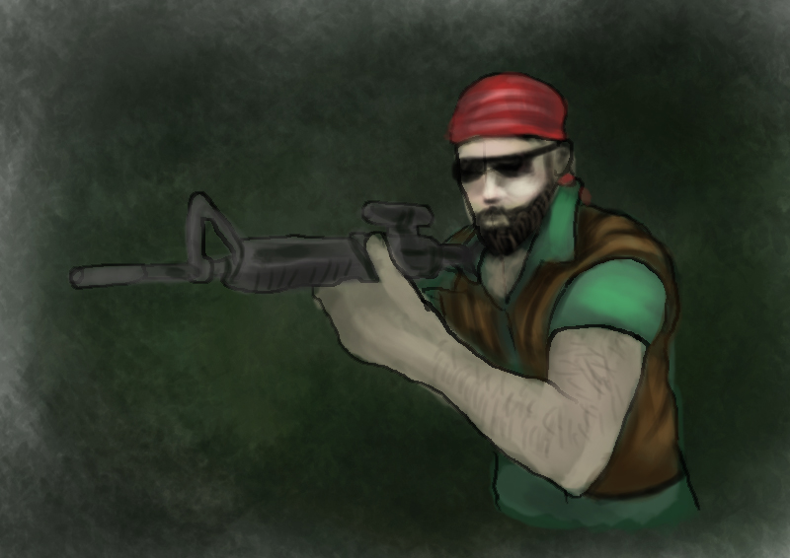
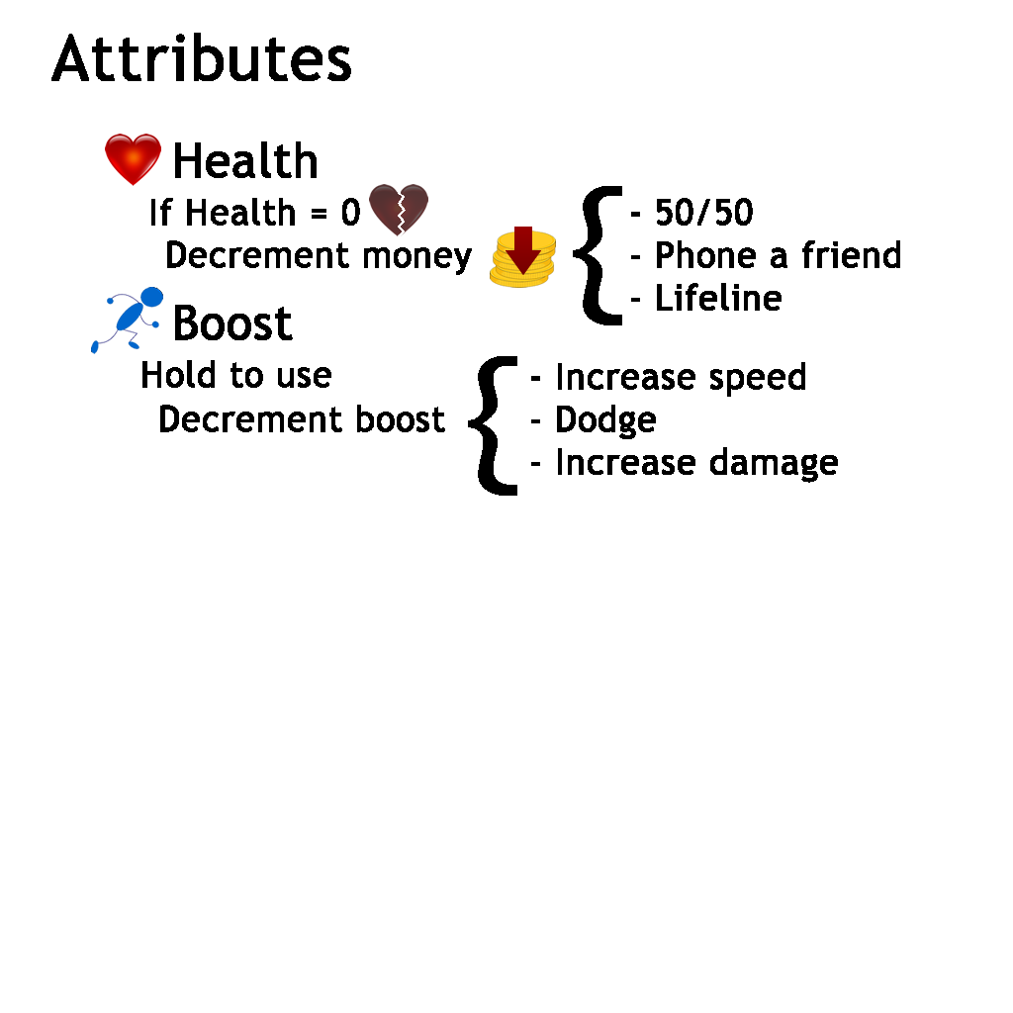
The Hero
The protagonist is a muscular man wearing body armor and sporting a variety of weapons.

Slide 11
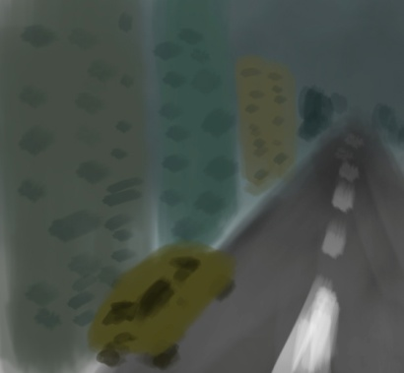
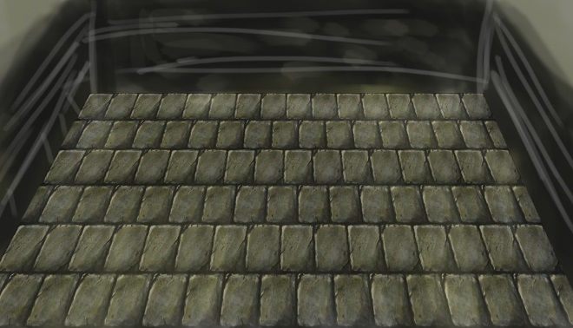
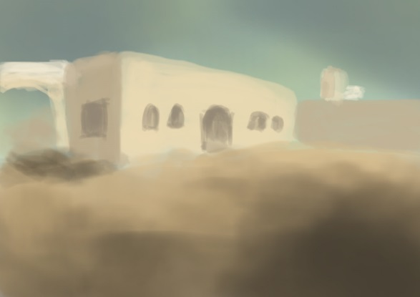
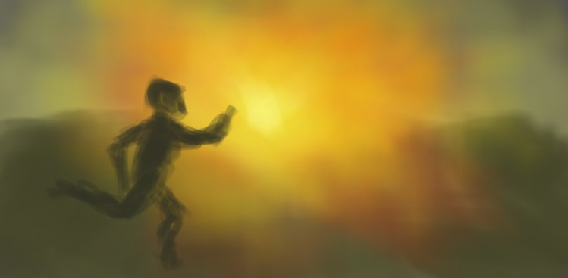
Where
A Virtual Reality Space with many possibilities

Slide 12
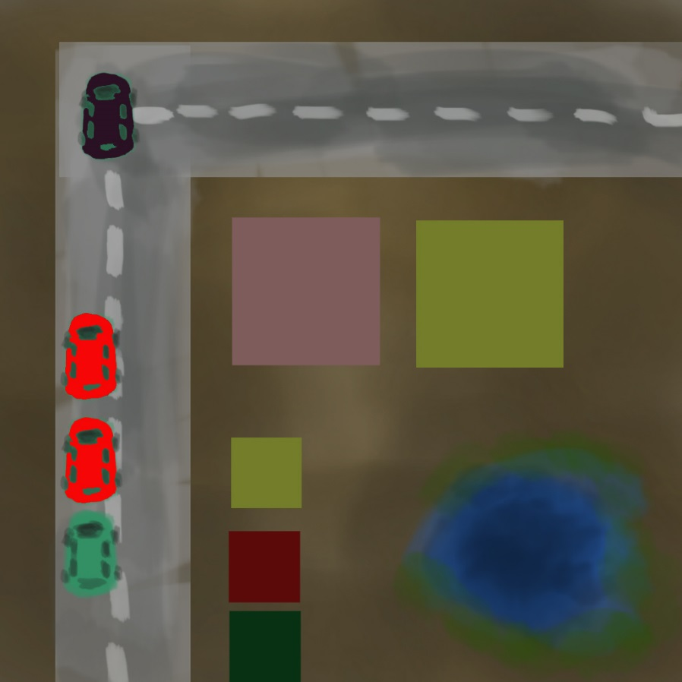
Urban Area
Where
An arena filled with buildings and debris

Slide 13

Where
Coliseum Arena
A flat, hexagonal arena with obstacles in the middle

Slide 14
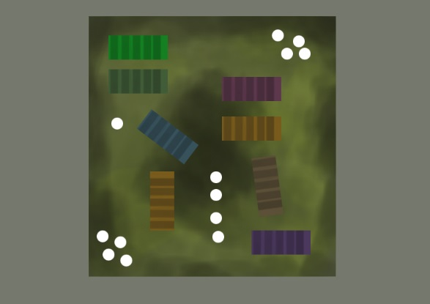
Level Layout
Player Spawn
Enemy Spawn
Enemy Spawn

Slide 15

Goal
To earn the prize money for winning at the game show

Slide 16
HUD
Health meter, Boost meter and Weapon + Ammo

Slide 17
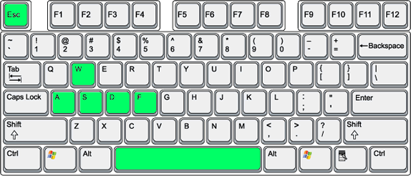

Controls
Pause
Melee
Shoot
Move
Boost

Slide 18
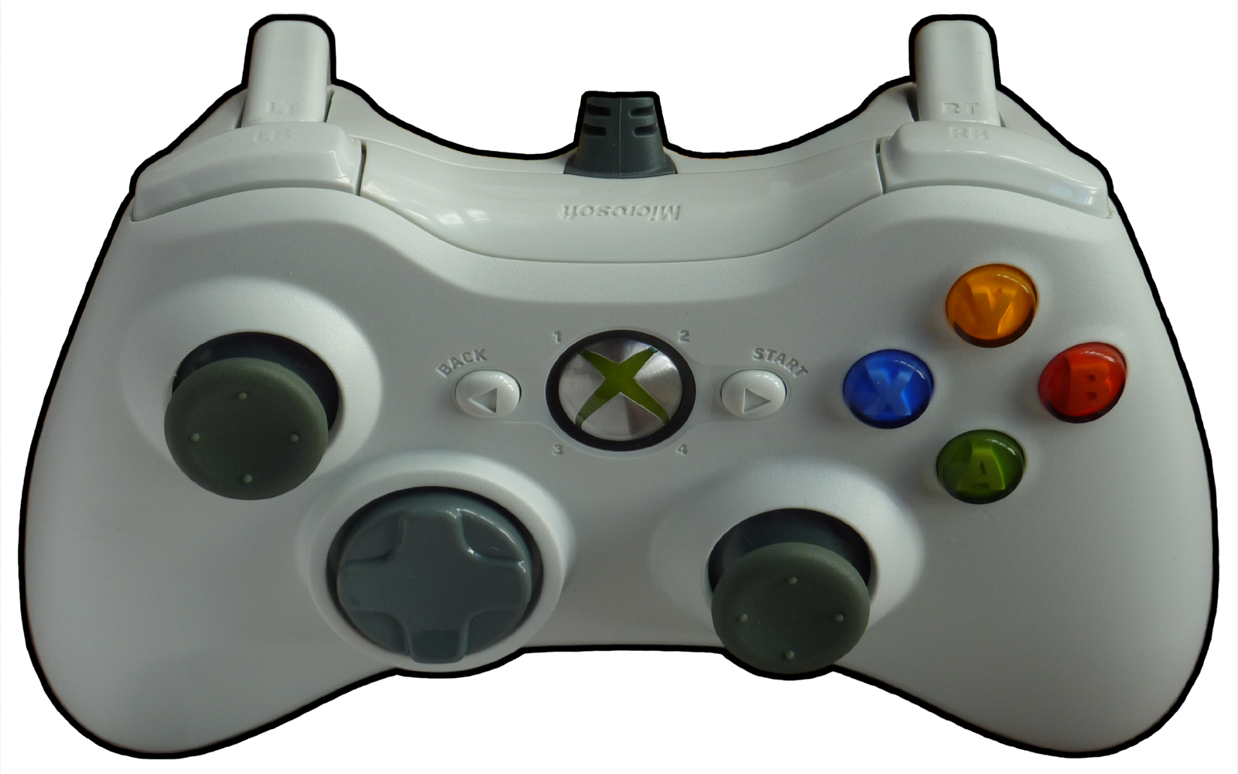
Controls
Boost
Shoot
Aim
Move
Pause
Melee (tap)

Slide 19
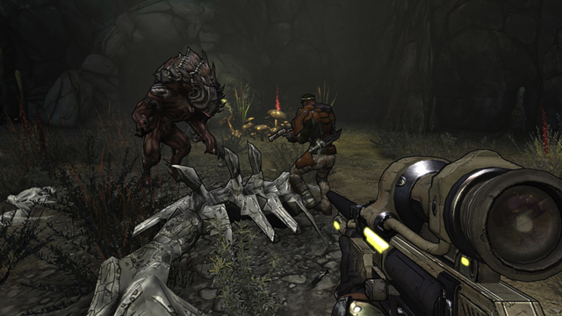
Art Style

Slide 20
Recap
Intense, fast-paced 1st Person Shooter
Occurs within a virtual world
You are an average Joe who wants to win the game show and get the prize money.

Slide 21
Questions?

